Slide 1

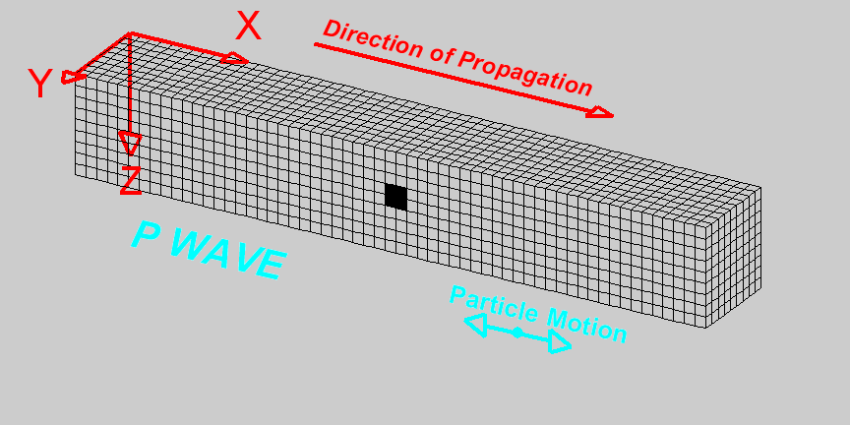

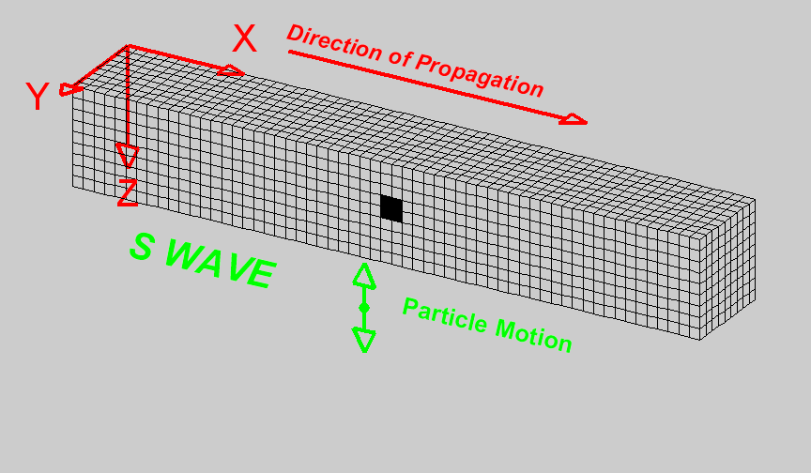

Seismic Methods for Education & Science !
Jeff Sposato
Deputy Director, AGL
(Braile, 2010)
Notes:
Outstanding in the field: AGL systems & the La Marque Geophysical Observatory
For those of you who don’t know me, I’m more of an Experimentalist, rather than a Theoretician.
And I want to assure you that no equations were abused during the preparation of this talk.
Now … What do I bring to the table at the Allied Geophysical labs?
Industry perspective, project management, a perspective on best practices, and integration of geology, acquisition, processing & interpretation.
Thanks for taking the time to come to this meeting. We know the challenges of time management and I know you will get plenty of bang for your buck.
I decided last summer to take early retirement from the O&G business to teach field methods. At my respective employers, I’ve been involved with the hiring of young men & women for the past 30 years. I came to see that some students didn’t know much about the oil business. And they sure didn’t understand geophysical field work!
Here’s a place that I can make a difference! We need feed stock for the geophysical profession and schools need to ‘do our best’ to prepare their students for entering the E&P business.

Slide 2
What Are We Doing?
Objectives:
Education
Technology - D
Data Provision
Solve Problems
Notes:
What are we trying to do? The Objectives are as follows:
1. Education – produce young professionals, who are prepared to enter the O&G industry
2. Technology Development – push the limits of existing technology look for ideas. Test them. Shoot them down. Try again.
3. Data Provision – I’ll talk more on that, but it’s the idea that data doesn’t just “appear”. It’s created! It IS an experiment. There should be documentation. You must identify potential source of errors and reconcile with the imaging objectives.
4. Solve Problems. We are brought “problems” from around the industry. We work on them. And, we come up with some solutions (ideas / recommendations, etc.)

Slide 3
How Are We Doing It?
Existing tools -push further
Resources in the Houston
Get INVOLVED !
Encourage … Own Data
Push the Envelope
Notes:
1. Use Existing tools –and push them further
2. Resources in the Houston - guiding the topics. This is Oil-Central USA
We talk to many in our industry and continue to stretch our base of contacts in the Houston community
A perfect example of this is talking with Andras, (Seismic Source Inc.) in our audience, on how we can interface a Radio Trigger Module to multiple energy sources, as well as multiple recorder types. This is the kind of ‘out of the box’ challenges we throw at the students.
Oh and Andras … a Big Thanks to you, John Giles and all the folks at SSI, who are helping to make AGL a leading group in creative seismic methods.
3. We Require students to get involved with field operations. These young guys & gals in the white shirts have been with me in the field. They are experiencing the challenges and rewards of team work. These are important for them to become the best geophysicists that they can become.
4. We encourage every student to acquire their own data for processing & interpretation projects.
5. This all leads our continued efforts to “Push the envelope” of mineral exploration methods.
& keep in mind safety in the workplace and industry ‘best practices’

Slide 4
Components of ANY
Seismic Field Operation
Source (P & S)
Receiver (3-C & VSP options)
Recorder (cable & node)
Positioning (Conventional & GPS)
Geophones
G(n) G(n+1)
Shot 1
$$ OIL ! $$
BLACK GOLD !
“ TEXAS TEA”
Notes:
Now to continue with the How …
Here’s some examples on how we are harnessing seismic methods for problem solving:

Slide 5

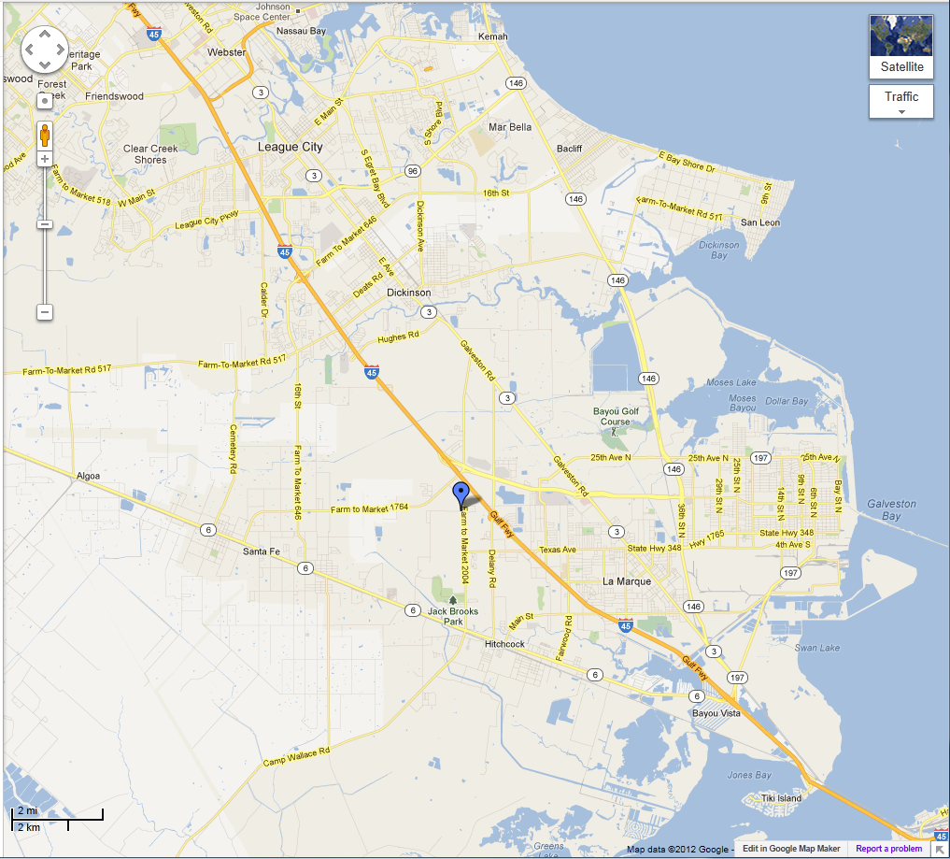
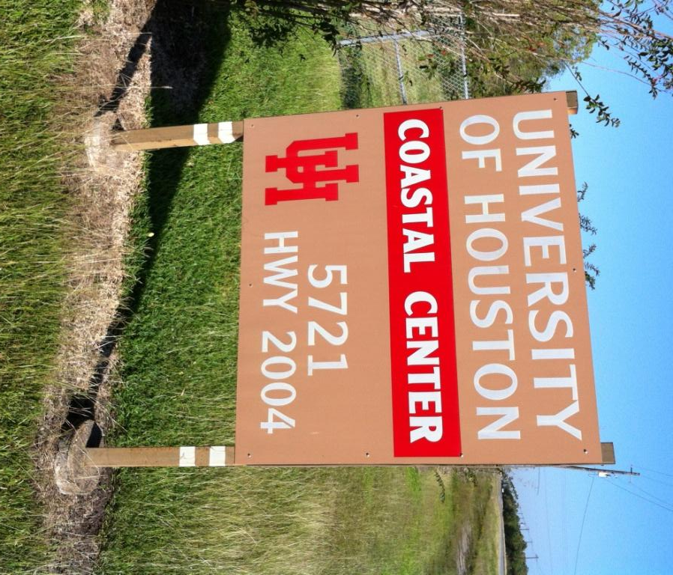
LaMarque Testing Observatory
UH Coastal Research Center
UH
Campus
I-45 Exit 15
CRC: 950 acre play ground
“Only 20 minutes from UH Campus”
Notes:
The AGL has acquired a number of datasets over the last year, from Montana to Texas, Louisiana to the Caribbean (Haiti, that is).
You will hear a number of interesting talks on these datasets throughout the day.
Our newest lab is located in Galveston County, just 20 minutes from campus.
At the beginning of this year, we drilled a couple boreholes, ~ 450 ft. each.

Slide 6
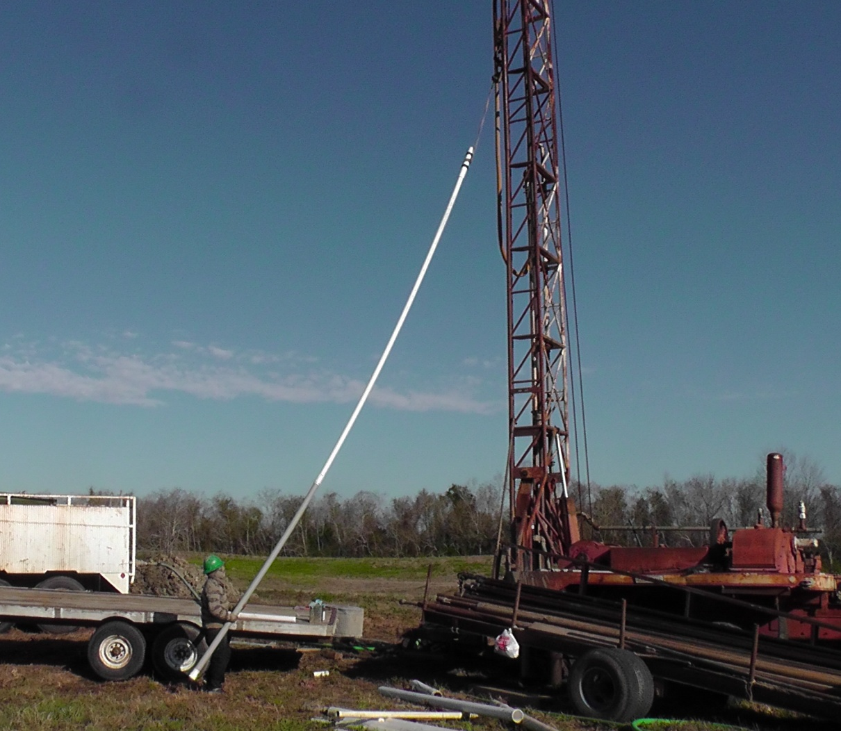
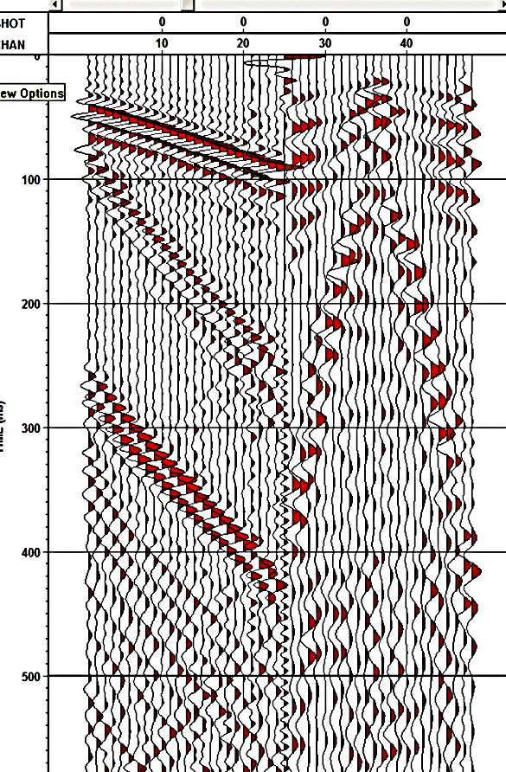
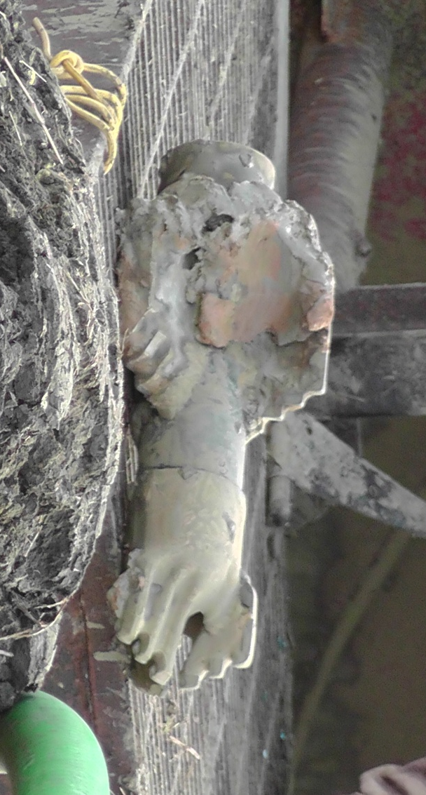
Bit / Bottom Hole Assembly / VSP
Packer
Production Tubing
Screen
Notes:
The upper picture is after drilling to TD, setting casing and completing the cement job.
The driller is now setting the bottom hole, production string.
& for your entertainment, the lower photo is the drill bit used for this operation. The bottom part is a 3-blade, 4 inch bit and it’s attached to a 7 inch reamer.
A walk away VSP is shown on the left, with a surface seismic line run, as well.

Slide 7

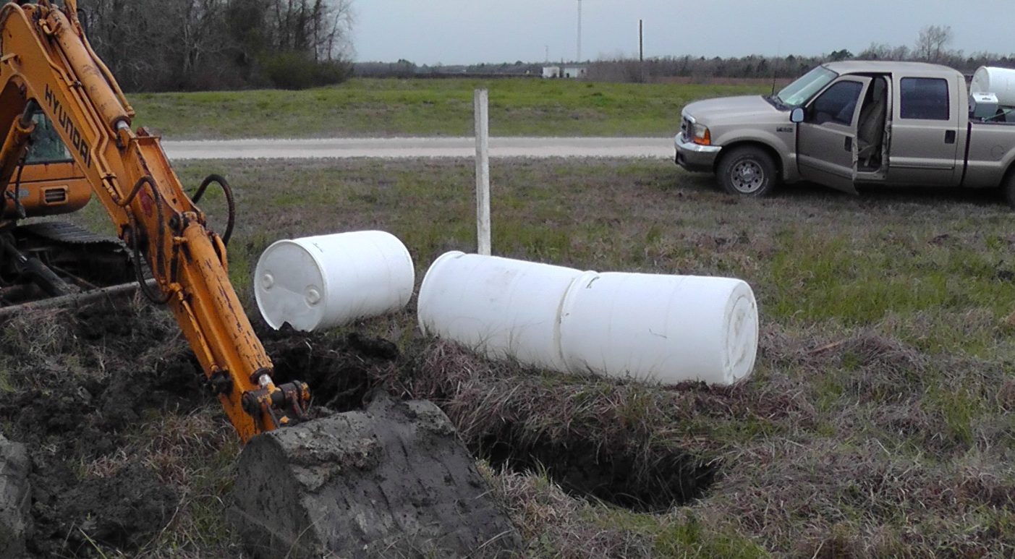
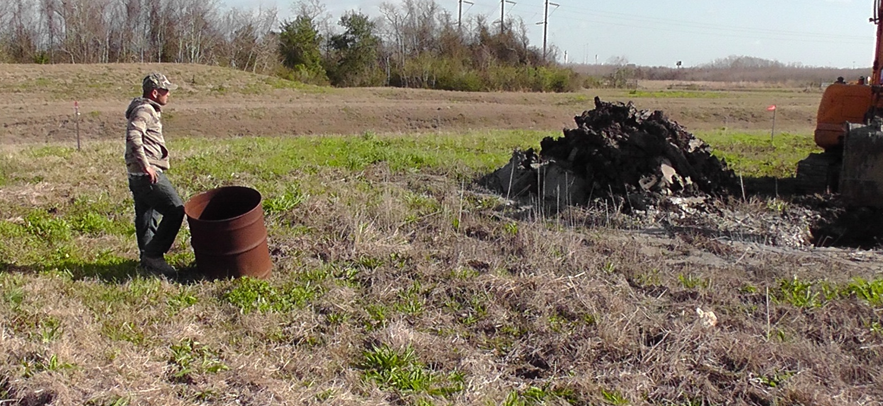
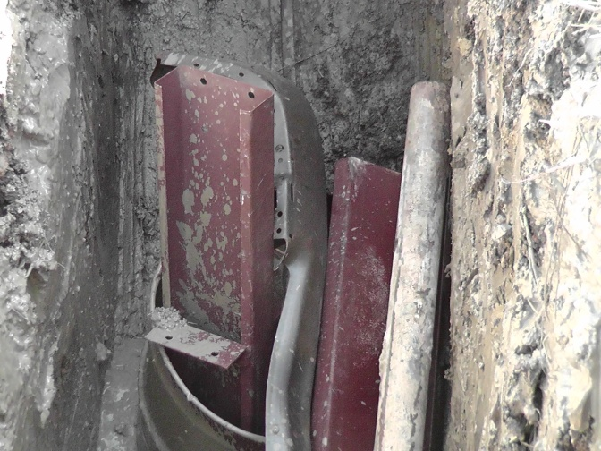
But … That’s Not All !
Near surface targets:
GPR
Electric Methods
Notes:
But that’s not all we are doing at the LaMarque Geophysical Observatory!
While the drillers were “making hole”, I borrowed their track hoe and dug a few holes for near-surface geophysical experiments.
A GPR (ground penetrating radar) device should be able to resolve the plastic barrels, which were buried only 3 ft from the surface, and
the #200 of steel was set a little deeper, in hopes of locating by electric methods!
I put in 4 of these little babies; all a bit different. The students will be charges with locating and reporting on their findings.
It’s lab work. It’s real world. They will have a diversified background in geophysics, so they should be able to find work in many different arenas.
In our future, I see many hours of geophysical fun, out at the LTO

Slide 8
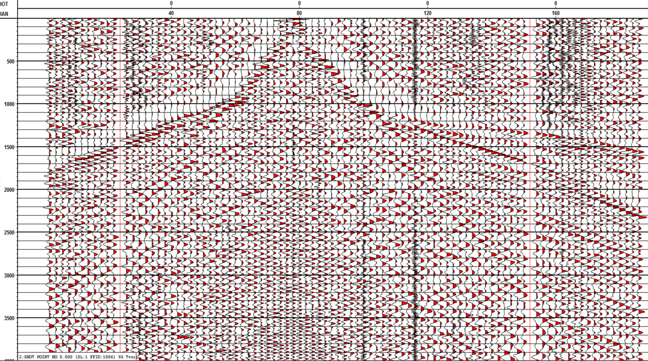
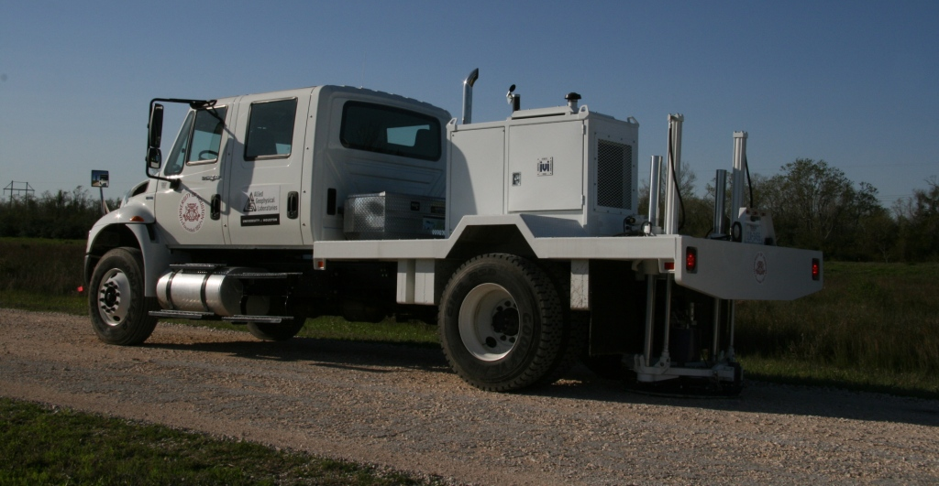
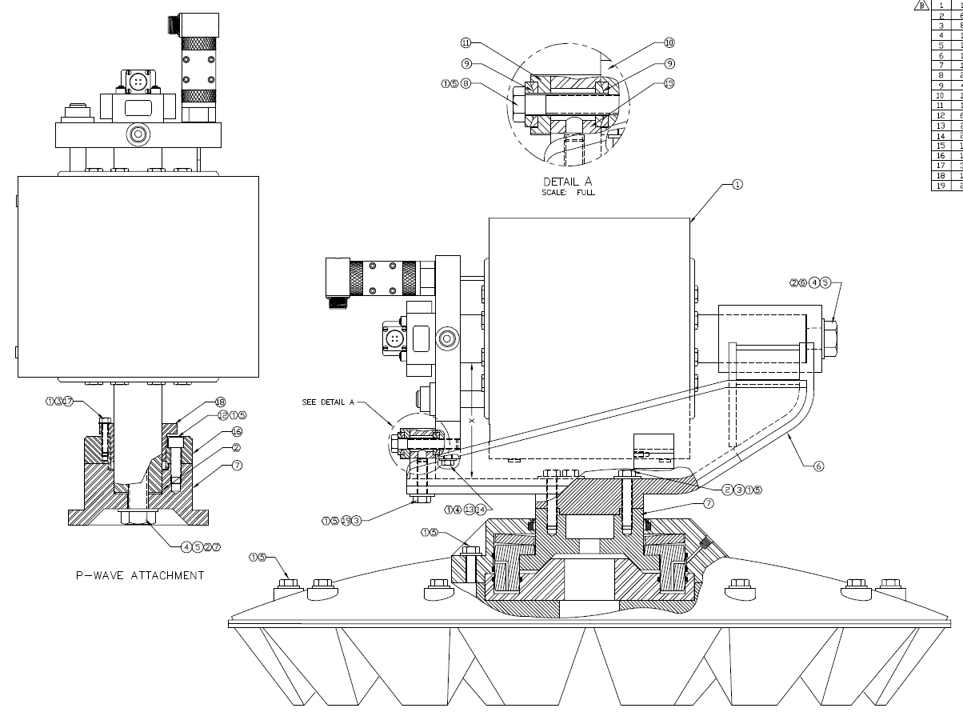
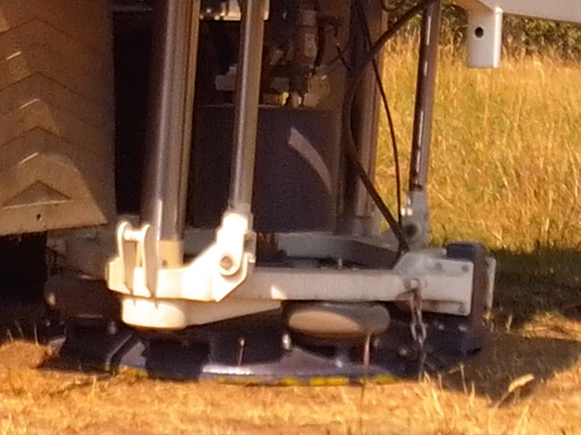
VIBROSEIS S-to-S
S-Wave
P-Wave
Notes:
Back to Our ‘Hows’, here’s some sample data of Shear vibe source to horizontal geophones.
Data is currently under analysis.
Please take some time to visit Ady Geda, out in the parking lot for a look at our IVI vibrator truck. Both the P and S-wave actuators are out there.

Slide 9

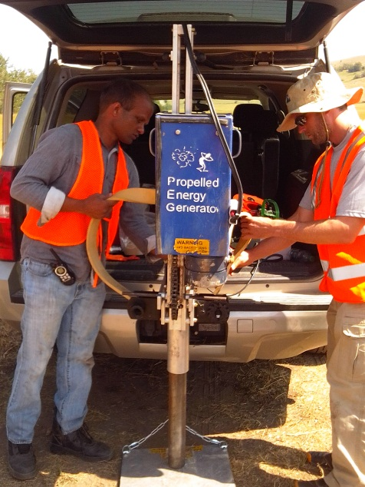
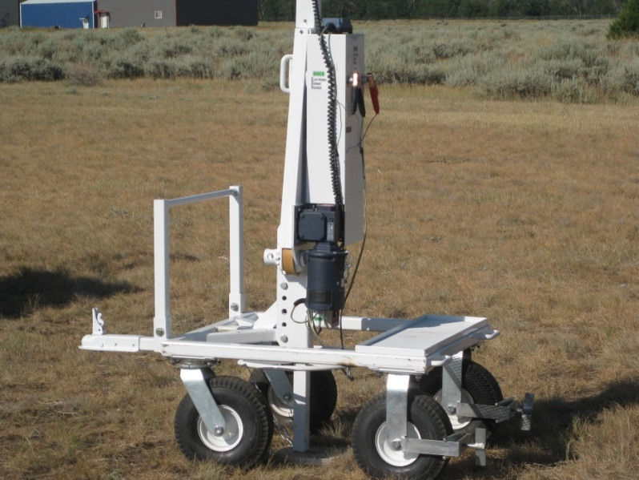
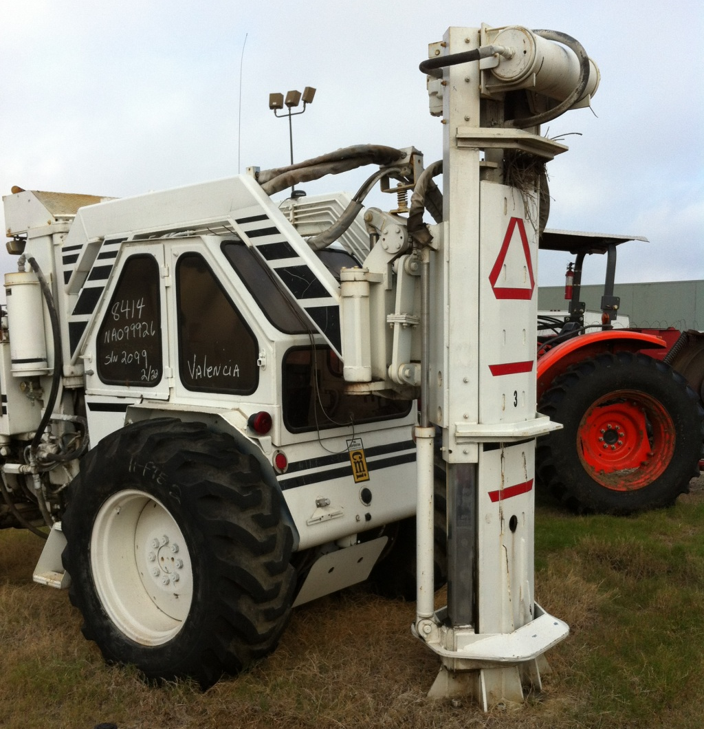
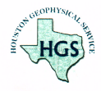
Seismic Energy Sources
Gisco “Whacker”
P- & S-Wave Source
Hydrapulse
P.E.G. source
THANKS
JIM!
Max Impulse:
12,000 ft. lbs.
80 hp JD tractor
Notes:
Three other energy source we have include different forms of accelerated weight drops.
Propelled Energy Generator (PEG) a #50 accelerated mass. This fits on the back of a truck, with a regular frame-mounted trailer hitch.
Gisco Seismic Source (w/ #200 hammer) has both P- and S- wave capabilities, by rotating the direction of energy delivery.
And a big thanks to Mr. Jim Acker of Houston Geophysical Service, Inc., who donated a Hydrapulse energy source to UH. This is an excellent, repeatable source, with 10,000 ft. imaging capability in the Gulf Coast region.
Great features of this unit is the similarity of interfacing to commercial seismic operations. A super teaching tool.
It practical to perform 3D surveys with sources like this.
Some maintenance & repairs are needed to get this fully operational. (~ $30K). This one of reasons why you need to support AGL.

Slide 10
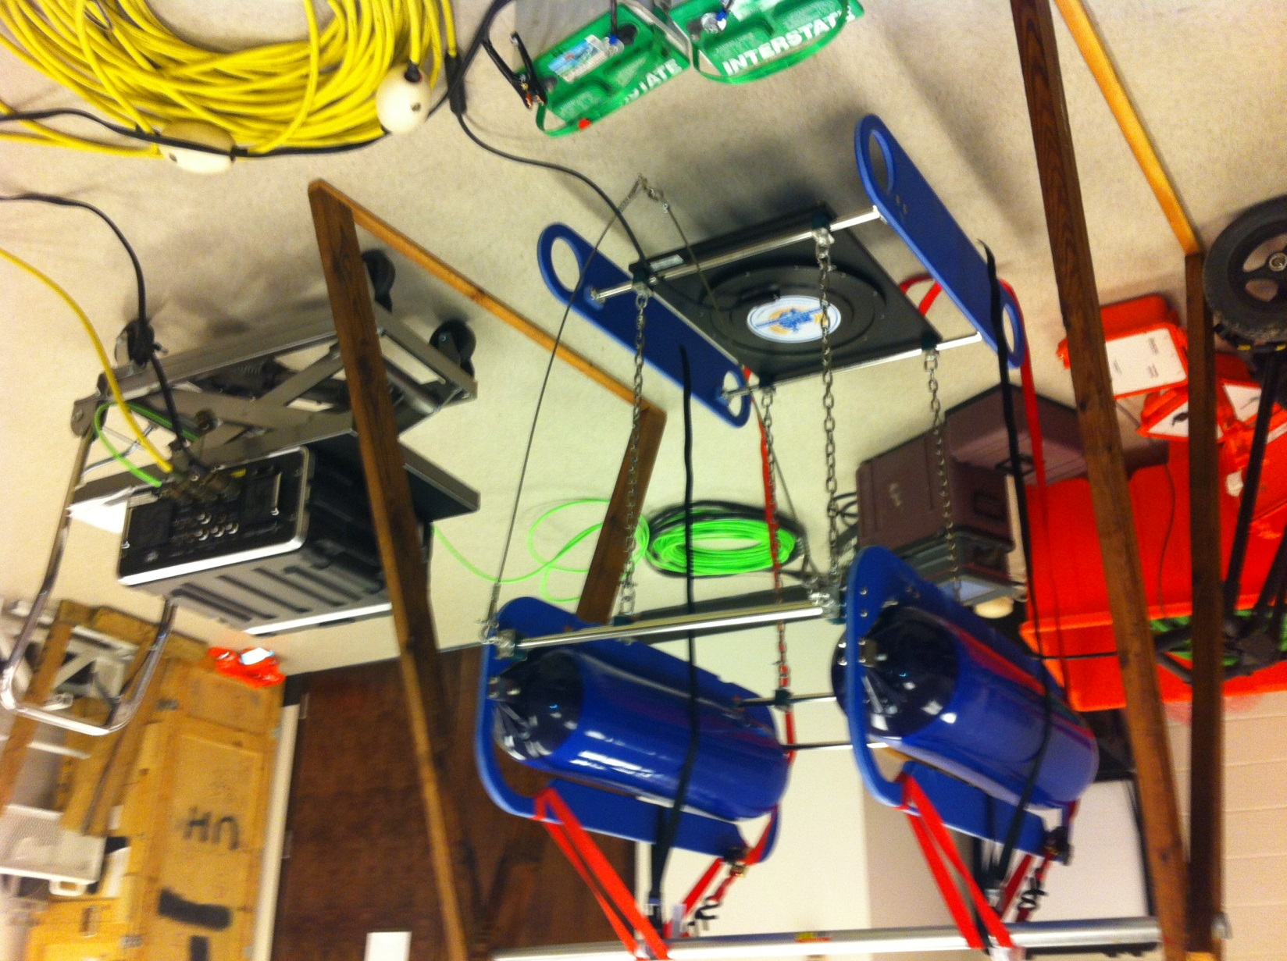
Don’t Forget Marine …
24 V system (2x truck batteries)
2-person portable
Self-contained sensor (hydrographic)
Direct interface to Geometrics (CDP method)
Notes:
A future direction we are going is in the shallow water marine & hydrographic areas.
We have acquired a high tech source, called a Bubble Pulser. It generates a clean 400 Hz signal that can image from 100 to 150 m in sediment.
It’s easy to move around and rig-up, plus it can interface with our existing geometrics cable system. We already have a micro eel, 24 channel streamer.
Next year, I will give you a report on successes of our marine seismic operation.
You want to hear it???

Slide 11
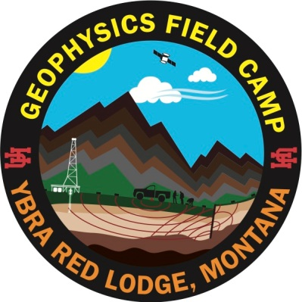
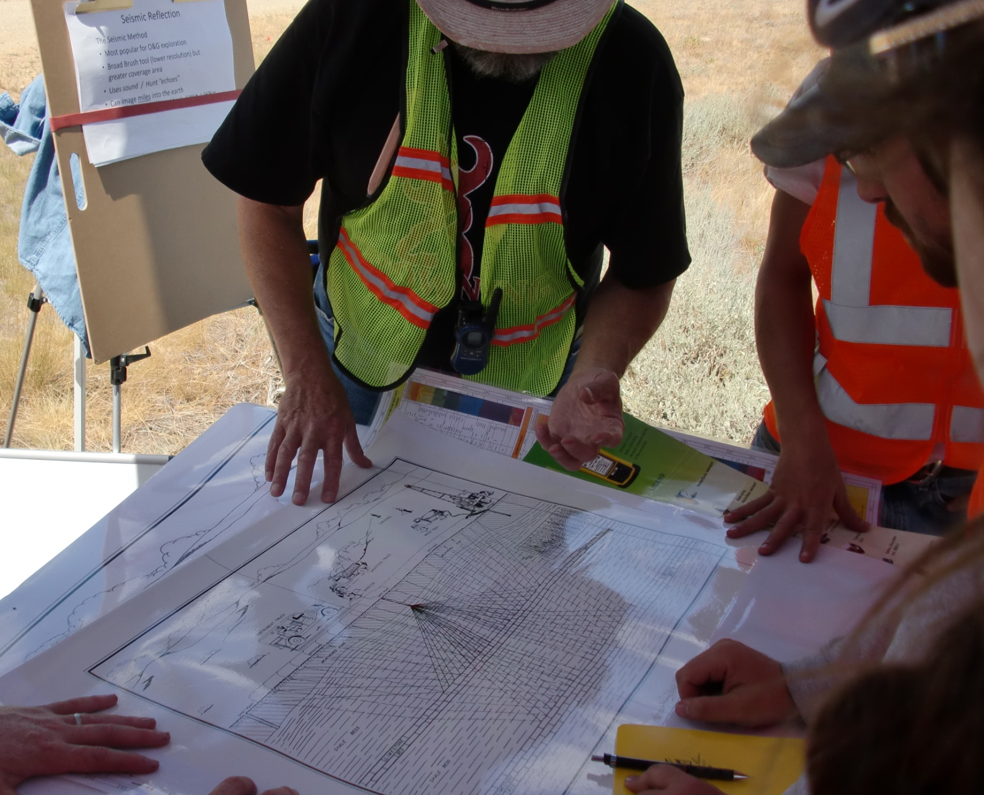
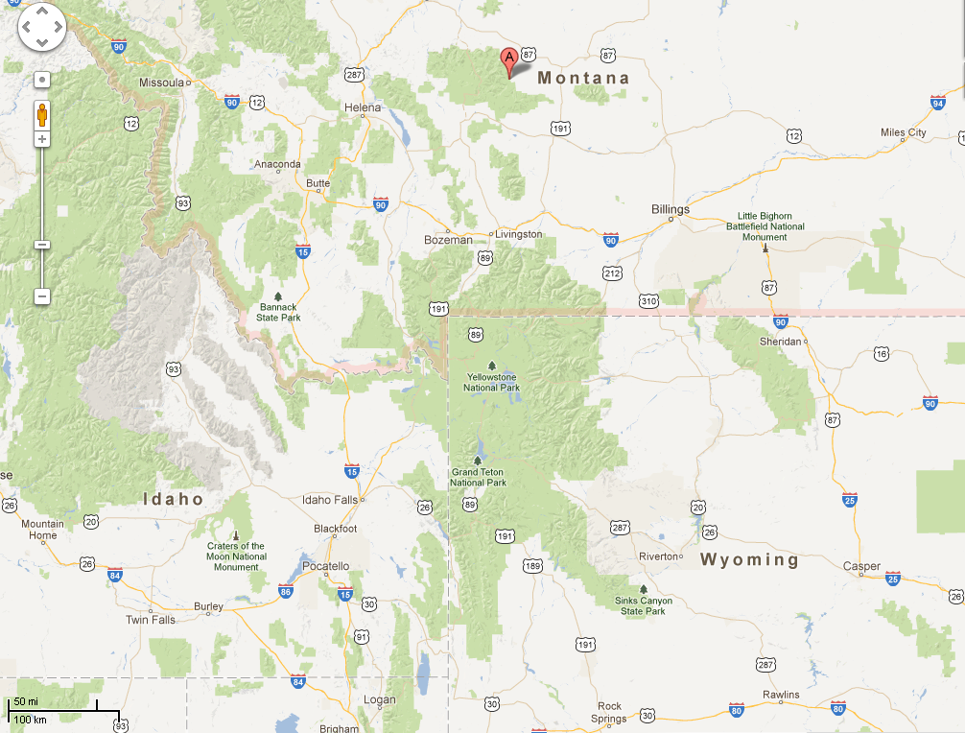
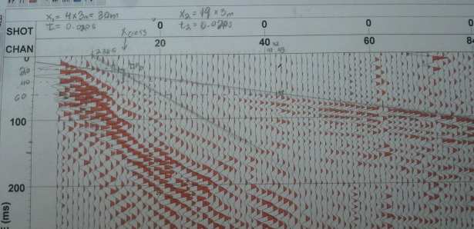
Yellowstone Bighorn Research Assoc.
Red Lodge
Notes:
Every summer we hold a geophysical field camp. This was the reason I took early retirement!
The dream of being the northland, at cooler temps and definitely lower humidity was a big draw.
I had been talking with Rob for a couple years on helping out as an instructor. Was thinking about taking vacation.
Then I just decided to jump in. What’s happened is I went head first, and now I’m up to my boots!
We had over 35 students last year and probably will have about the same this year.
The seismic is from a refraction exercise, with Geometrics recorder and sledge hammer source.

Slide 12
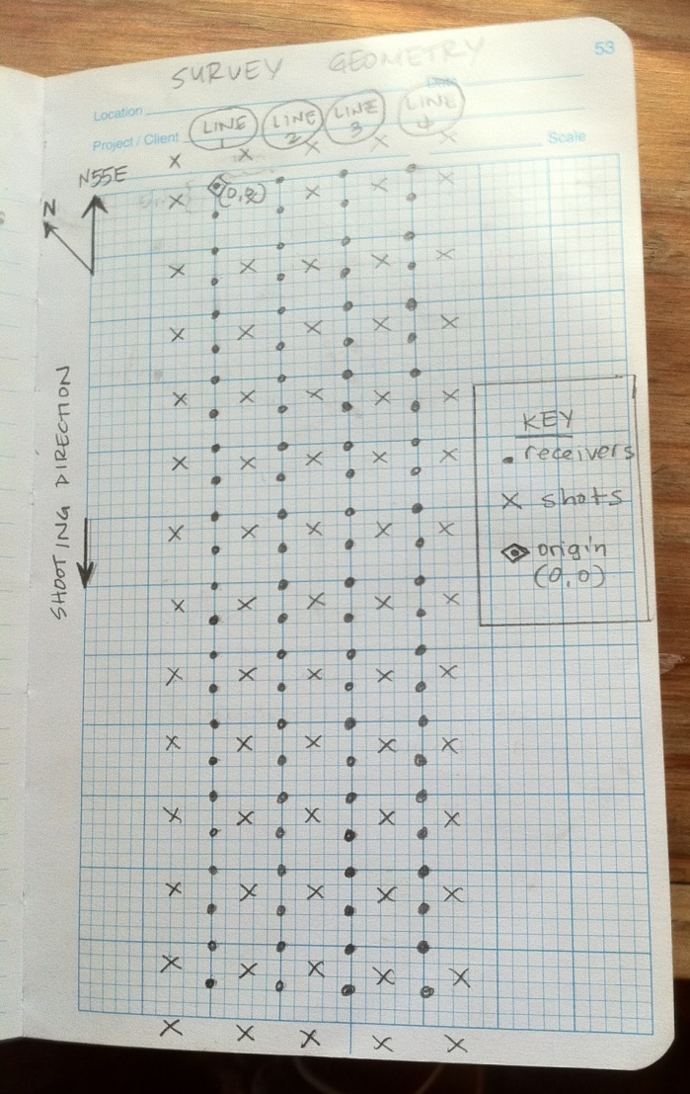
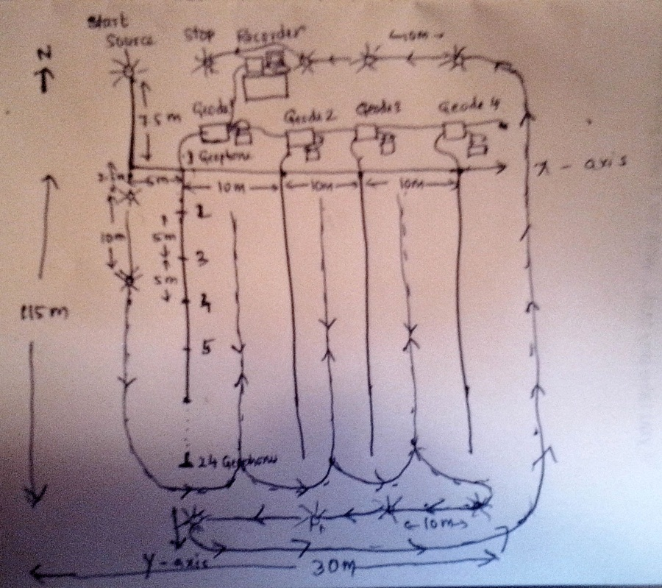
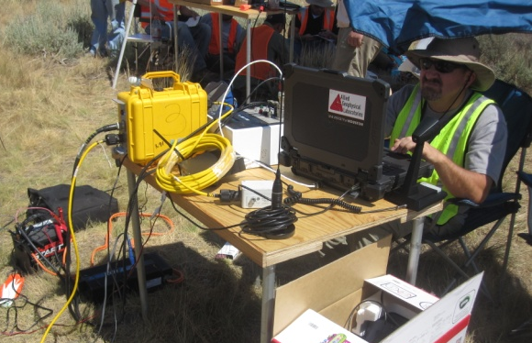
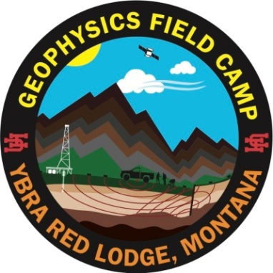
3D Seismic Exercises
Notes:
Yellowstone Big Horn Research Association
GEOPHYSICS FIELD CAMP 2012
3D design & Recorder set-up (looks like a rats-nest of wiring)

Slide 13
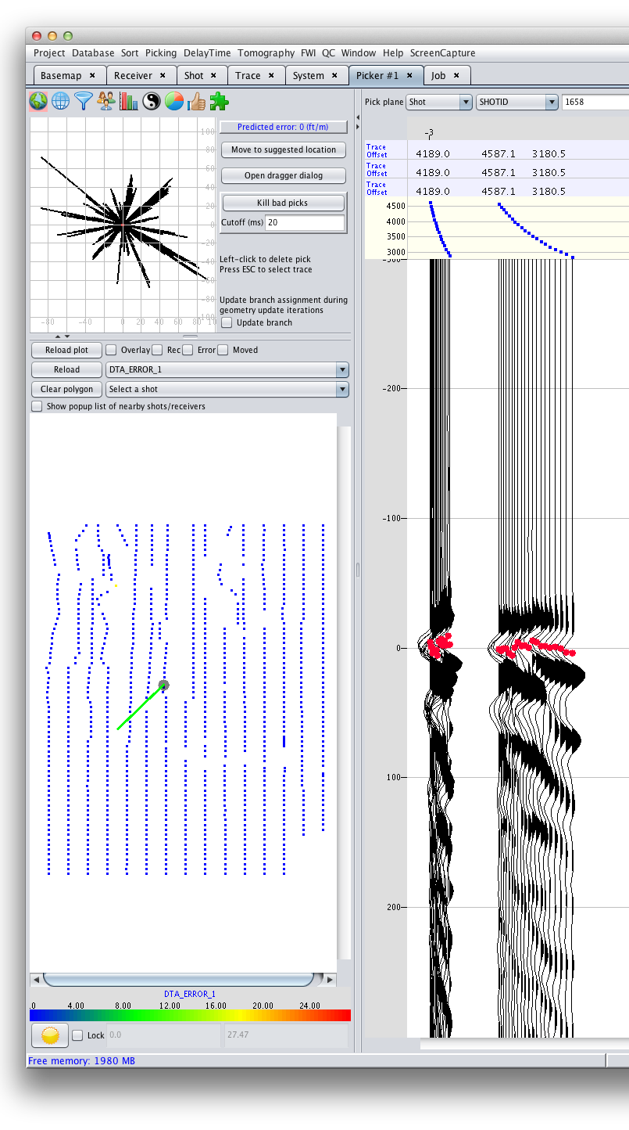
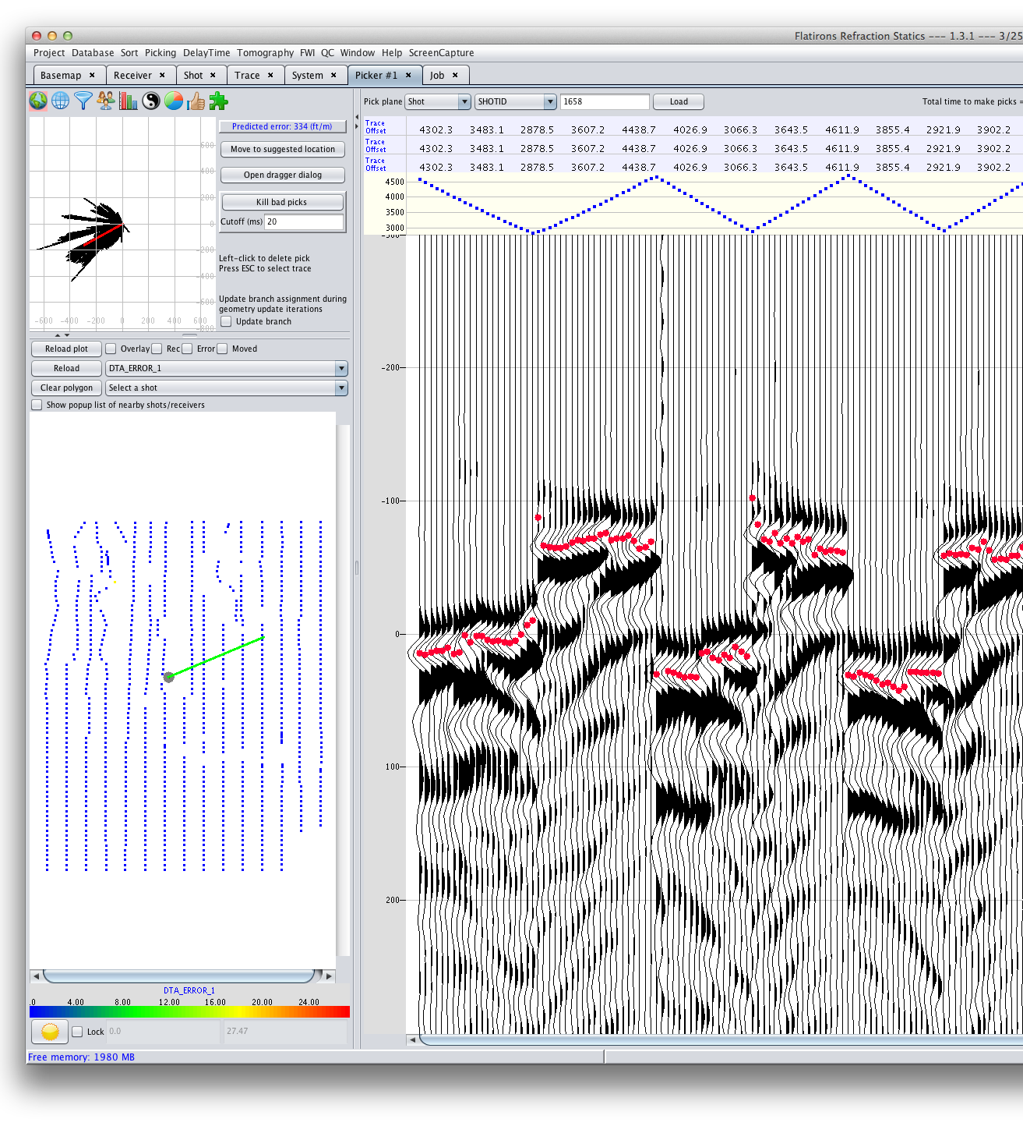

Industry Commitment to UH AGL: Geom. Repair / Refraction Statics
All seismic processing is effectively
“geophysical interpretation”.
Converting geophysical data to geological models. (Diggins, 2013)
BEFORE AFTER
Notes:
PC based XtremeGeo
Use directly in the field
Resolve survey issues “On Location”
Chuck Diggins & Matt Duiker creators of the following software packages:
Miser @ Western
Fathom @ Green Mountain Geophysics
Stratus @ Maverick Geo
Seismic Studio @ Renegade
The new application is called ‘Flatirons” and we are getting copies of this to use in the field for evaluation of newly acquired data.
Again, this type of experience could easily aid our students in securing their first job, in the business. We are teaching skills!

Slide 14
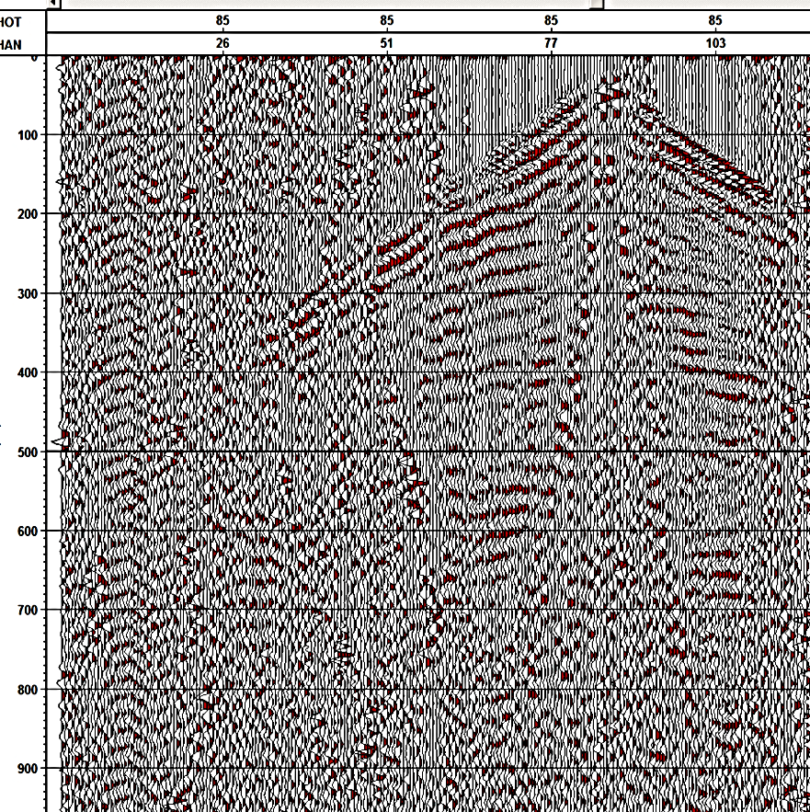
Autonomous Node
Seismic Systems
GPS sensor
A/D & memory
Acoustic Sensor
Source
Logger

Slide 15
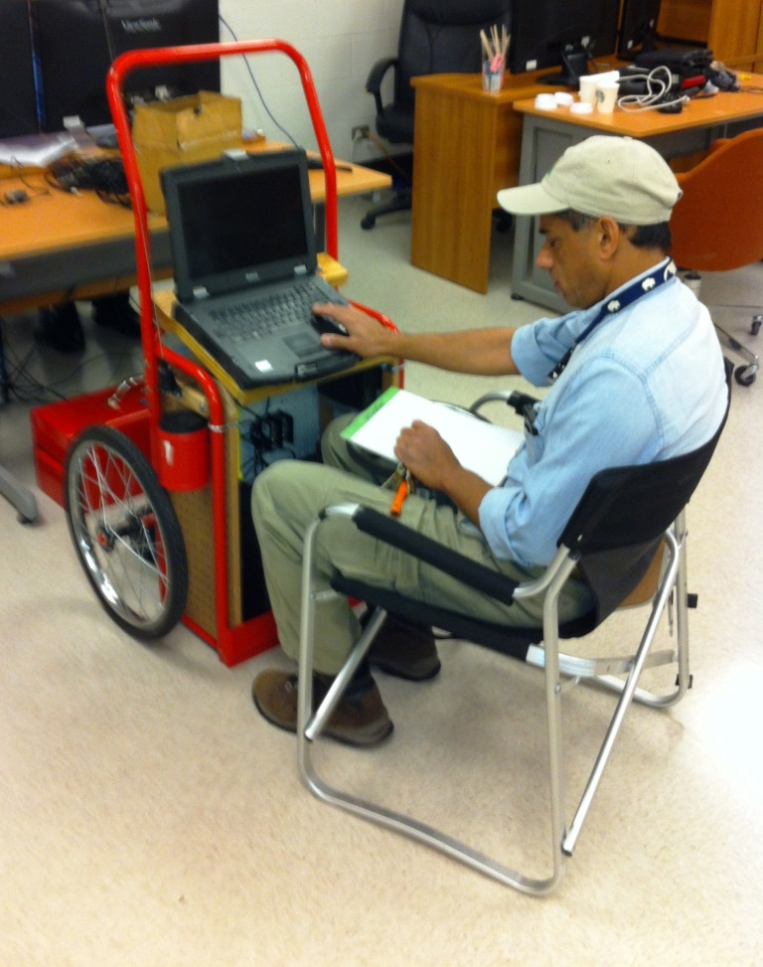
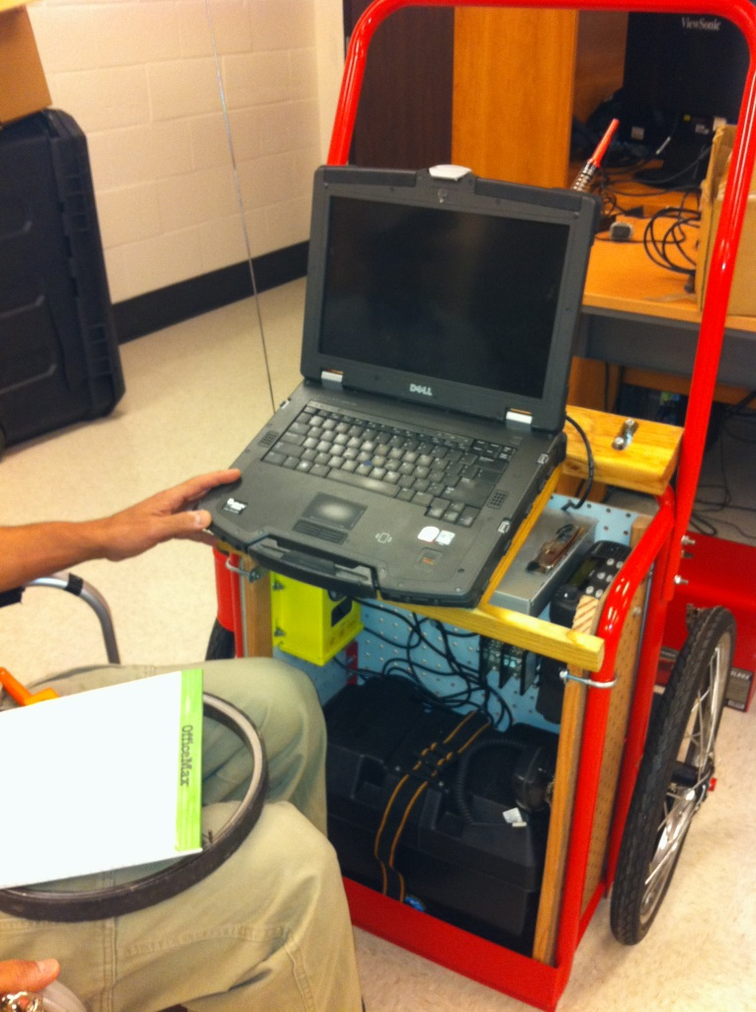
Portable “Handtruck” Doghouse
Observer Interface
(HD PC w/ control S/W)
Paper log sheets
Line Interface Module
Source Encoder
VHF Radio
Independent Power via
Deep cycle battery
Notes:
Here you see the evolution of the recorder ‘doghouse’. This is a work-in-progress project, but be done completed before we drive off to Montana.
This self contained cart has all the necessary components for a modern distributed recording system.
Since the data come from the line cable in digital form, we only have to use an interface module to the network plug of the laptop.
Other key components are an source controller. [We call it the encoder] And a good quality VHF radio.
See the 12V deep cycle battery to power everything?
This is an example of trying to do field work smarter, rather than harder.

Slide 16
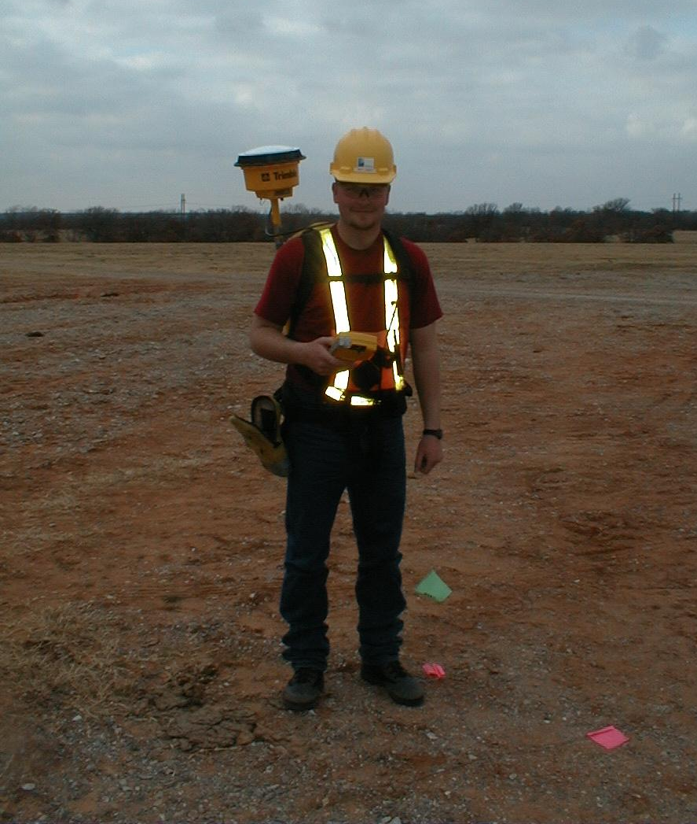
Surveyor
(GPS / Data Collector / PPE)
How many Personal Protective
Equipment items can you identify?
Notes:
Here’s an example of discussion points we have @ UH.
Safety, or HSE discussions are integral in all the field work we under take.
But, what I really want to talk about is the equipment you see here.
This is an industry-grade GPS backpack, with seismic application software integrated.
We don’t have the budget for this gear, yet.
But, with your support, I hope we will get to this level of technology, so our future geophysicists will be best prepared for their careers.
($20 K)

Slide 17
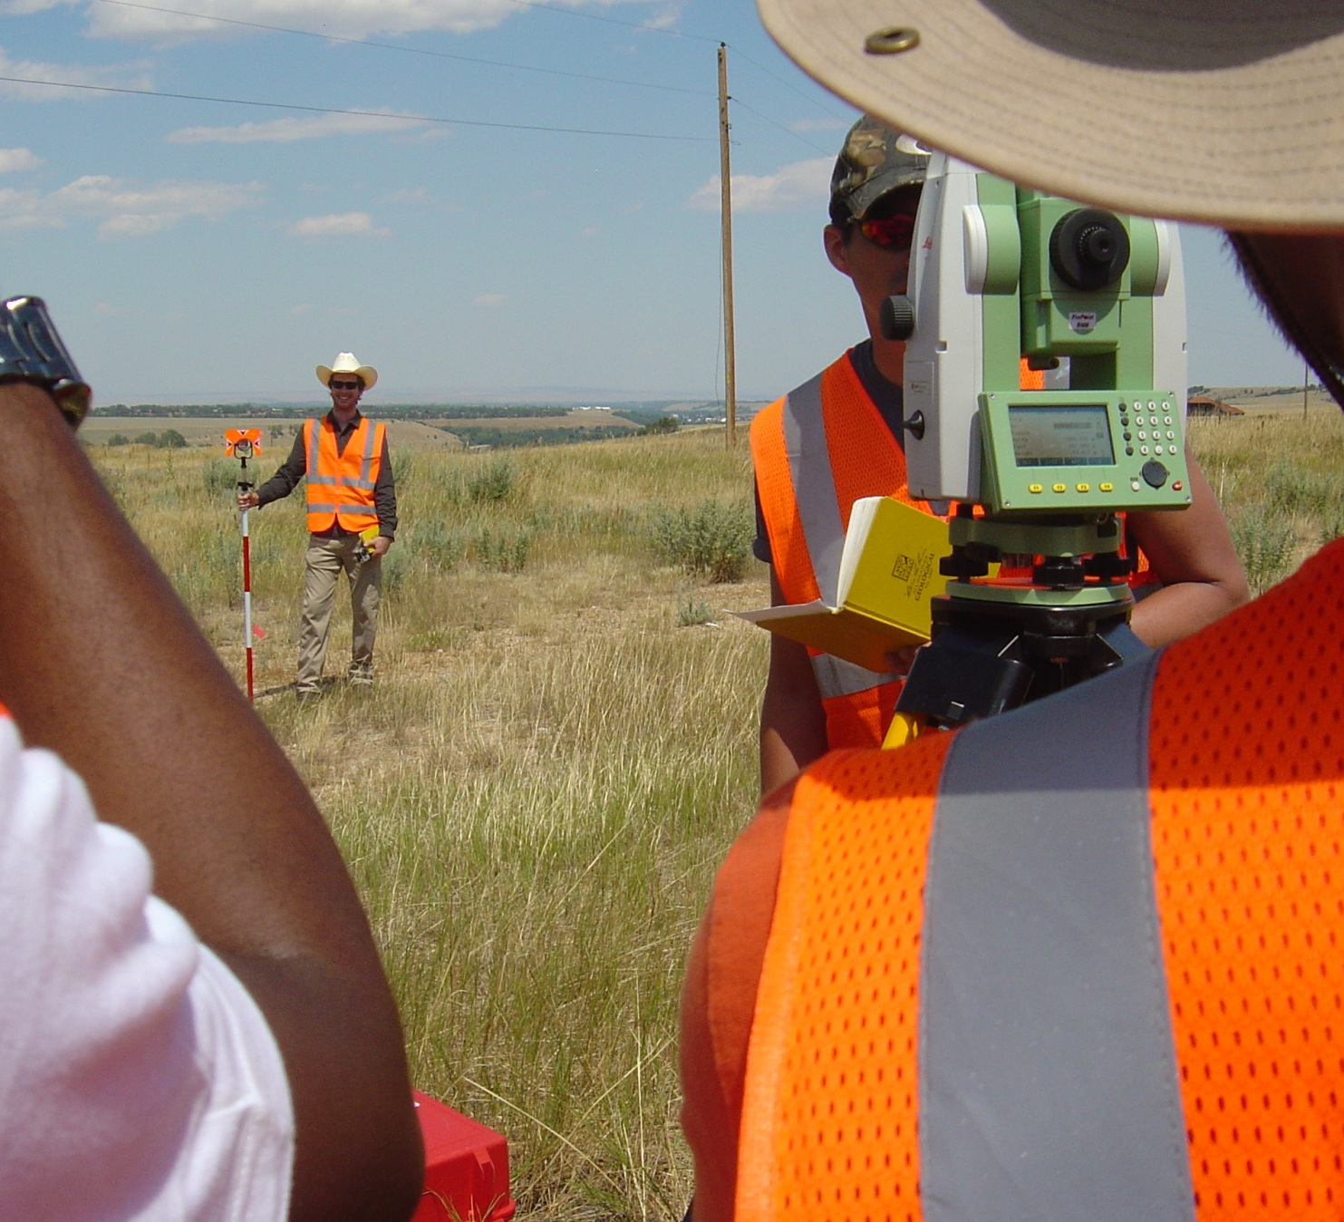
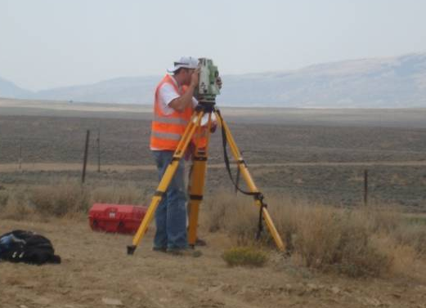
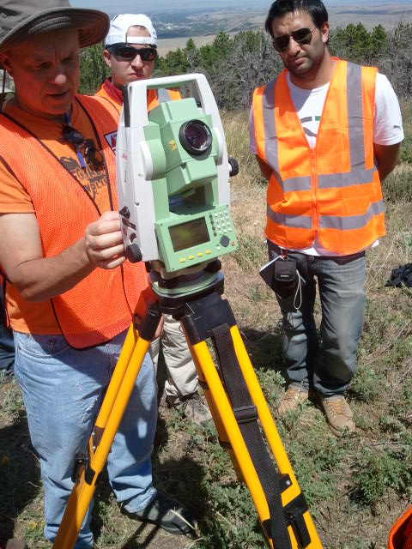
Positioning: It’s NOT a “Lost” Art!
Notes:
Here’s a fabulous example of empowering the students.
The total station you see is a ________. Completely digital.
Did you know that ‘surveying’ is an antiquated term?
The modern word is ‘geomatics’, as we integrate spatial information from a number of sources.
It’s a lot of data management. Including GIS.
That’s how we have digital basemaps with culture data. All those pesky ‘shape files’.

Slide 18


THANKS !
Jeff Sposato PG-TX
Deputy Director
Allied Geophysical Laboratories
University of Houston
File: LTO_Boreholes2013.pptx
Notes:
Thanks for you time and your patience.
And not to be crass, but your support will keep these wheels of the AGL turning, so you can have effective products in young professionals, so you too can retire!

Slide 19
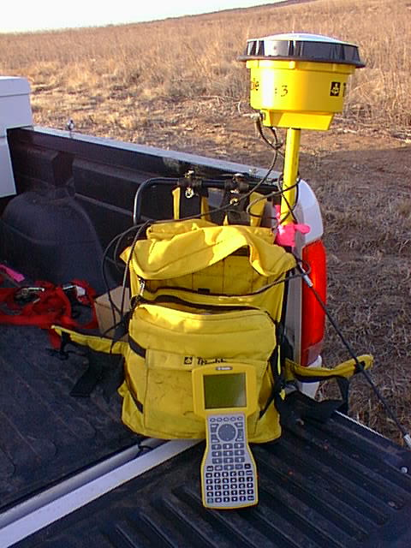
Field Surveying
GPS Satellite Antenna
& Electronics
Backpack
Full of Batteries
& Electronics
Ruggedized PC
Trimble 4800

Slide 20
Where We REALLY Are !
Geodetic Parameters / Survey Datum
Datum (Horiz.) : NAD-27
Projection : Lambert Conformal Conic Zone : LA South (1702)
Spheroid : Clarke 1866
Central Meridian: 91.33333333333333° W
Std Parallel-South : 29.3
Std Parallel-North : 30.7
Lat of Origin : 28.66666666666667
False Easting : 2,000,000 m
False Northing : 0
Units : US Survey feet
Vertical Datum : also to be identified

Slide 21
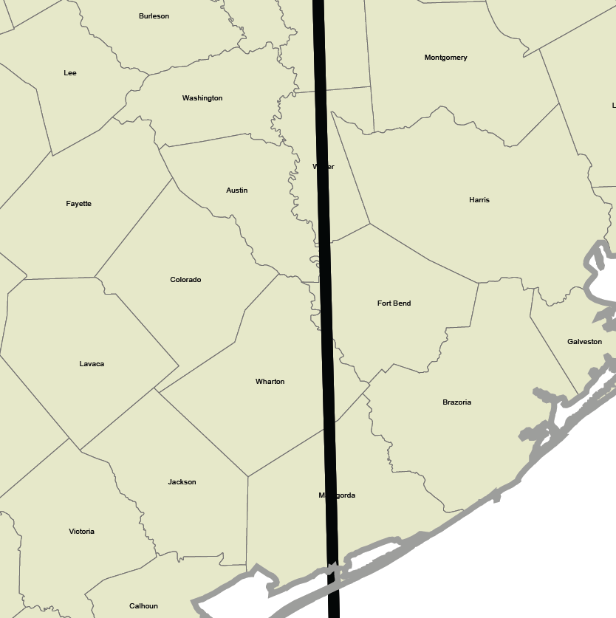
Universal Transverse Mercator
Zone 14 Zone 15
96 deg. West

Slide 22
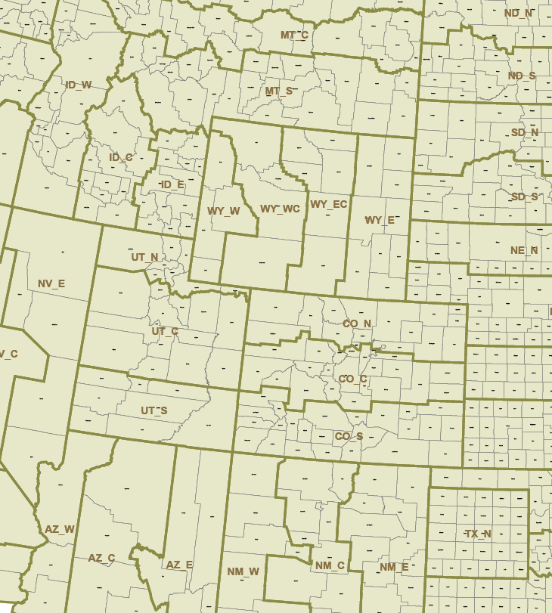
State Plane Coordinate System
Projections:
Wyoming: Transvers Mercator
Colorado: Lambert

Slide 23
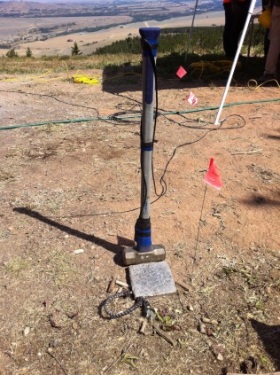
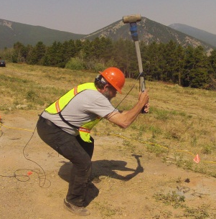
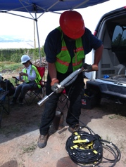
Source-Recorder Combinations
Hammer & Anvil:
Sledge & Plate
PEG
GSSI
Hydrapulse
Vibroseis:
P-Wave
S-Wave
VHF
Source
Decoder
Encoder
VHF
OB
Logs
Recorder
Geophone
Signals

